Slide 1

DECO ROBO Engineering Exploration Course Project
GROUP 7: N DIVISION
Sona Shetty 1441
Abhinav Shetti 1445
Krupa Patil 1416
Rajat Revankar 1457
Under the guidance of
Kaushik Mallibhat
2019-2020, Even Semester
CEER, KLE Technological University, Hubballi

Slide 2
PROBLEM DEFINITION
Designing a semi-automatic decorative which should be cost-effective, user-friendly, portable and aesthetically pleasing. We must be able to design the exterior of the decorative in a way that would attract more customers. We need to build a design that can be completed within a time duration of 2-3 months, falls under the budget of 2000 rupees, should be of dimension 20*20 sq.cm^2. We need to create a decorative that can show movements and emit lights of different colors and patterns. To add on, it will produce sound effects, display greeting and also be able to sense one's presence and only then perform the above-mentioned tasks.

Slide 3
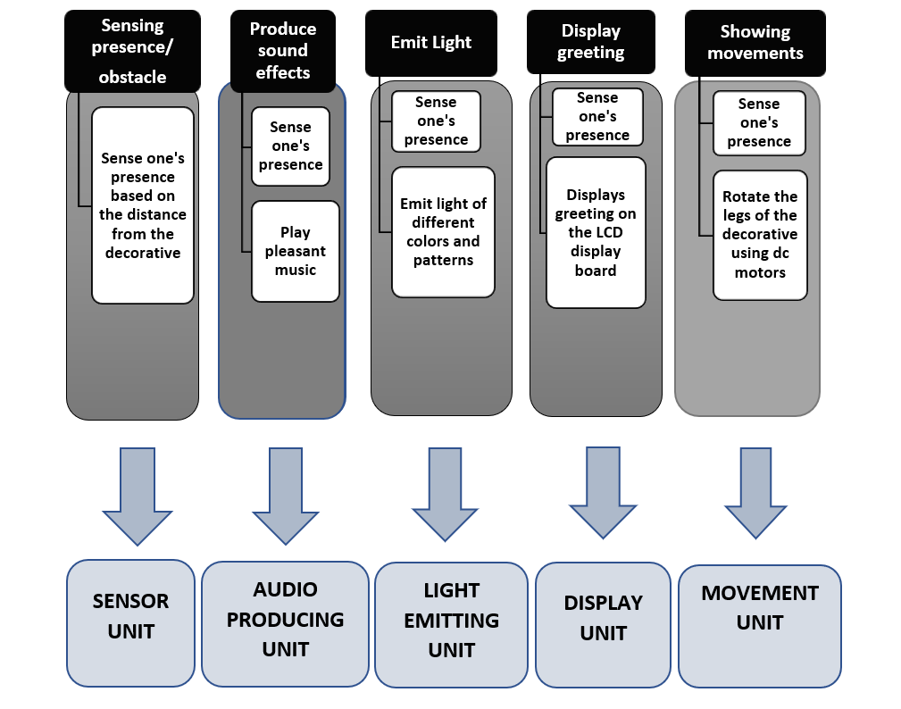
FUNCTION TREE AND FUNCTIONAL CLUSTERING
FUNCTION TREE:

Slide 4
SUB SYSTEMS IDENTIFIED
Sensor Unit(Input)
Light Emitting Unit(Output)
Display Unit(Output)
Audio Unit(Output)
Movement Unit(Output)

Slide 5
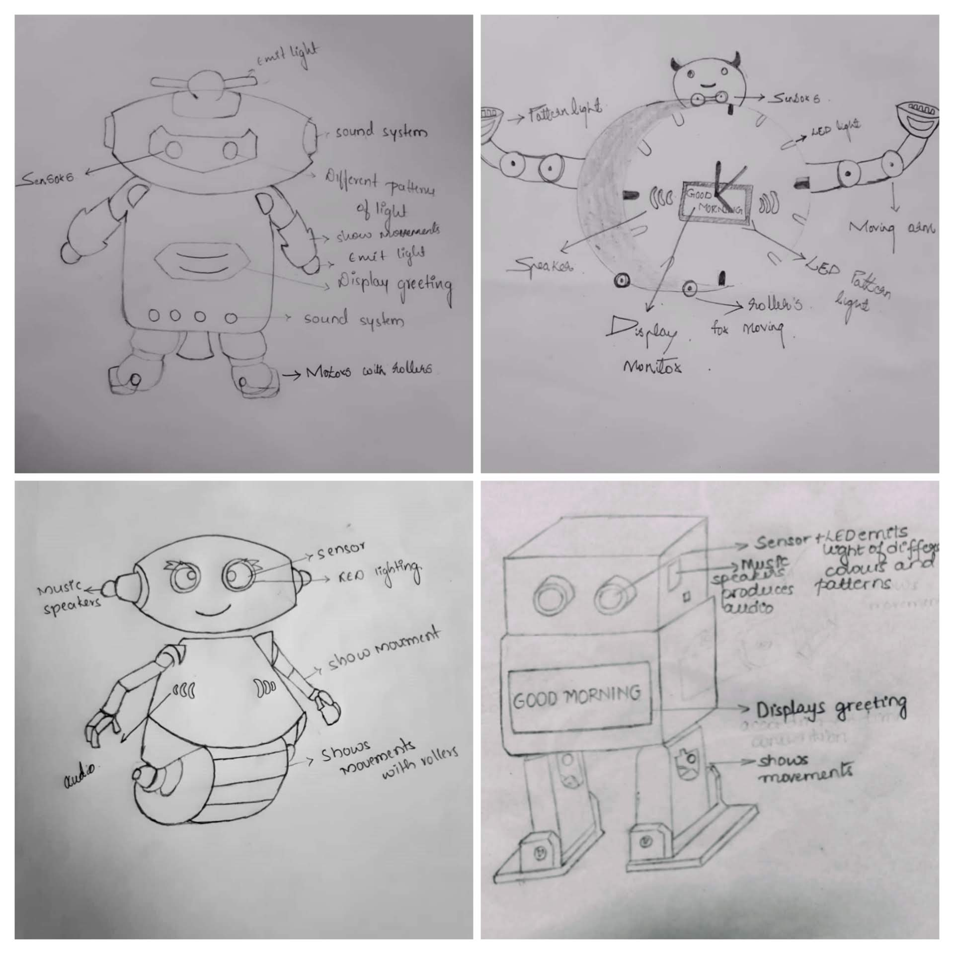
GENERATED CONCEPTS
CONCEPT 1
CONCEPT 2
CONCEPT 3
CONCEPT 4

Slide 6
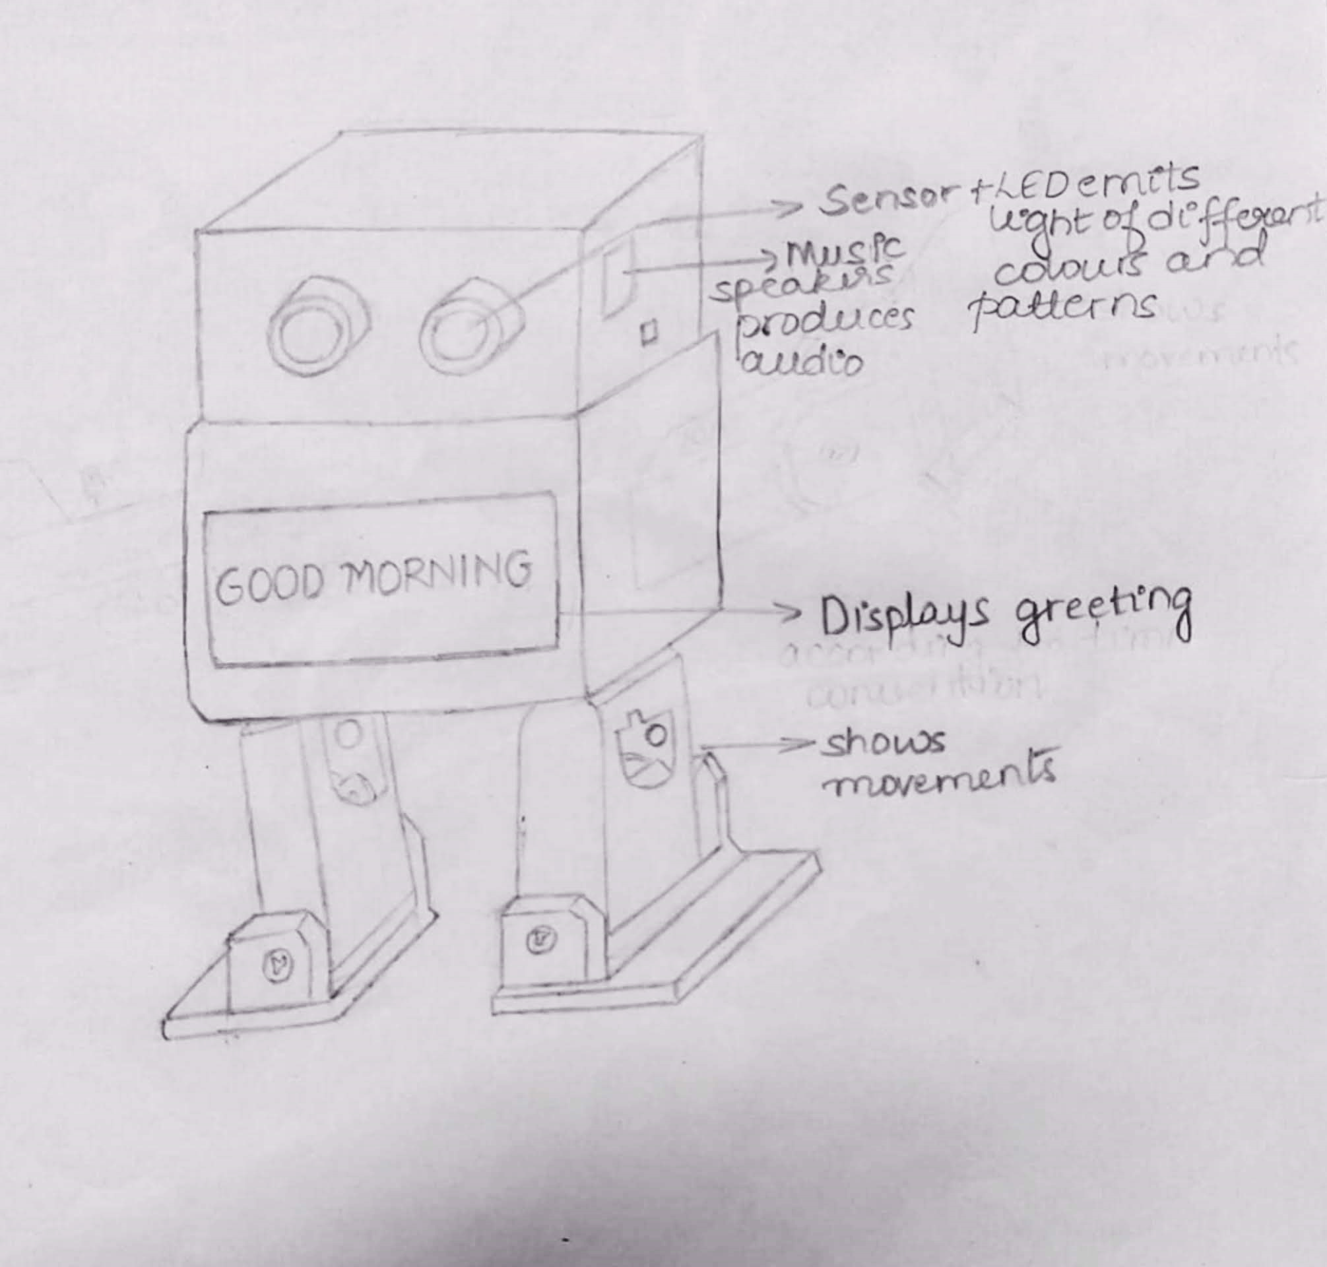
SELECTED CONCEPT
CONCEPT 4

Slide 7
PUGH CHART AND CONCEPT SELECTION
Assigned weightage for the stated objectives:
OBJECTIVES | WEIGHTAGE
SEMI-AUTOMATIC | 9
USER-FRIENDLY | 8
AESTHETICS | 7
PORTABILITY | 5
COST | 3

Slide 8
OBJECTIVES | WEIGHTAGE | DESIGN 1 | DESIGN 2 | DESIGN 3 | DESIGN 4
SEMI-AUTOMATIC | 9 | 0 | 0 | Datum | 0
USER-FRIENDLY | 8 | + | + | Datum | +
AESTHETICS | 7 | ++ | - | Datum | +
PORTABILITY | 5 | + | + | Datum | +
COST | 3 | -- | + | Datum | ++
+SCORE |  | 27 | 16 | 0 | 26
-SCORE |  | 6 | 7 | 0 | 0
TOTAL |  | 21 | 9 | 0 | 26
CHOOSING DATUM: Design 3
Justification: Design 3 is chosen as datum because it is semi-automatic, user-friendly, aesthetic, portable and cost-efficient.
The best concept generated is Design 4.

Slide 9
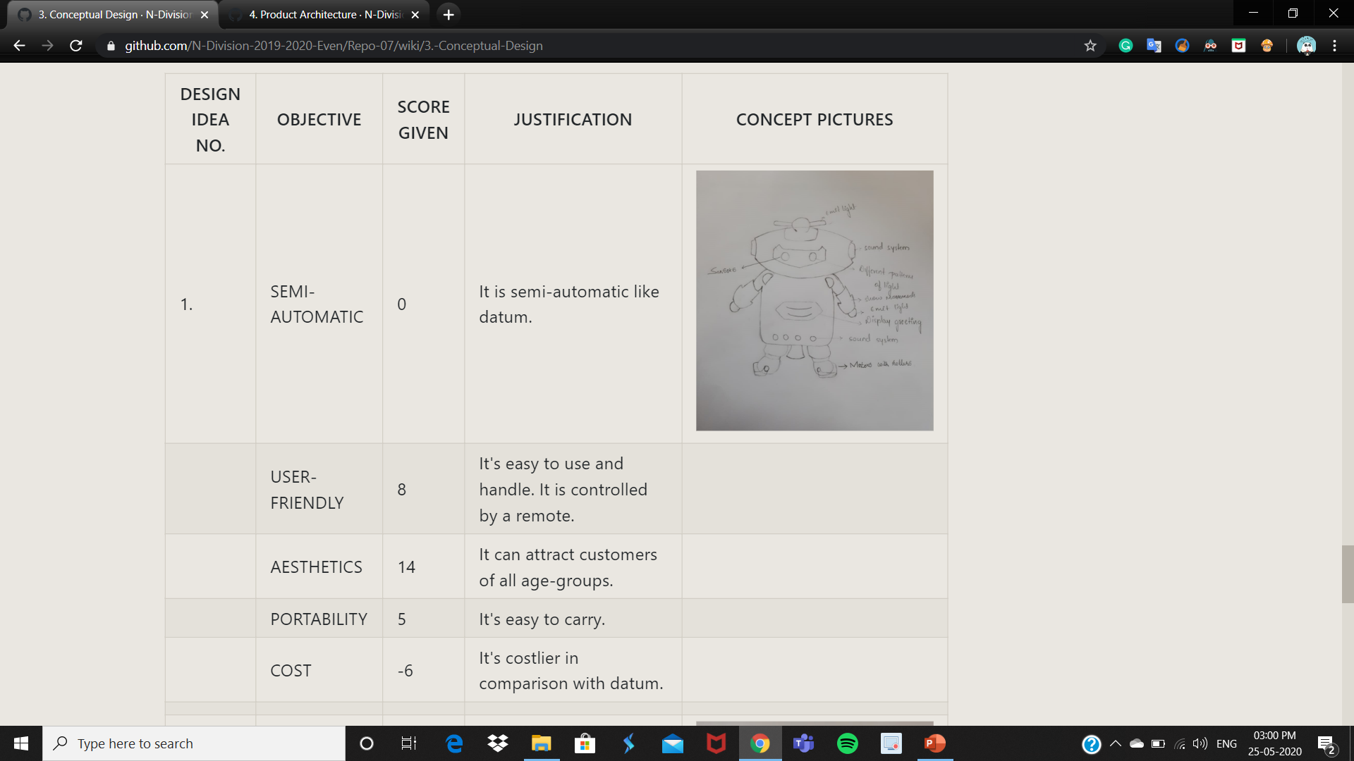

Slide 10
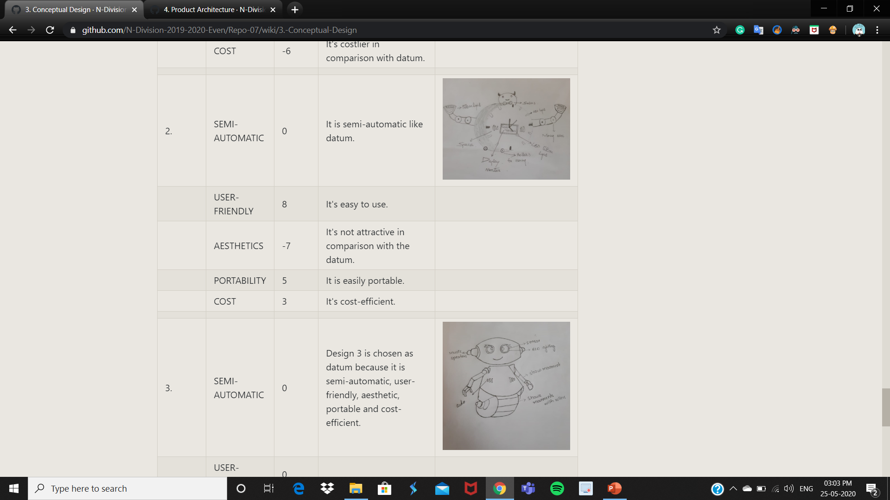

Slide 11
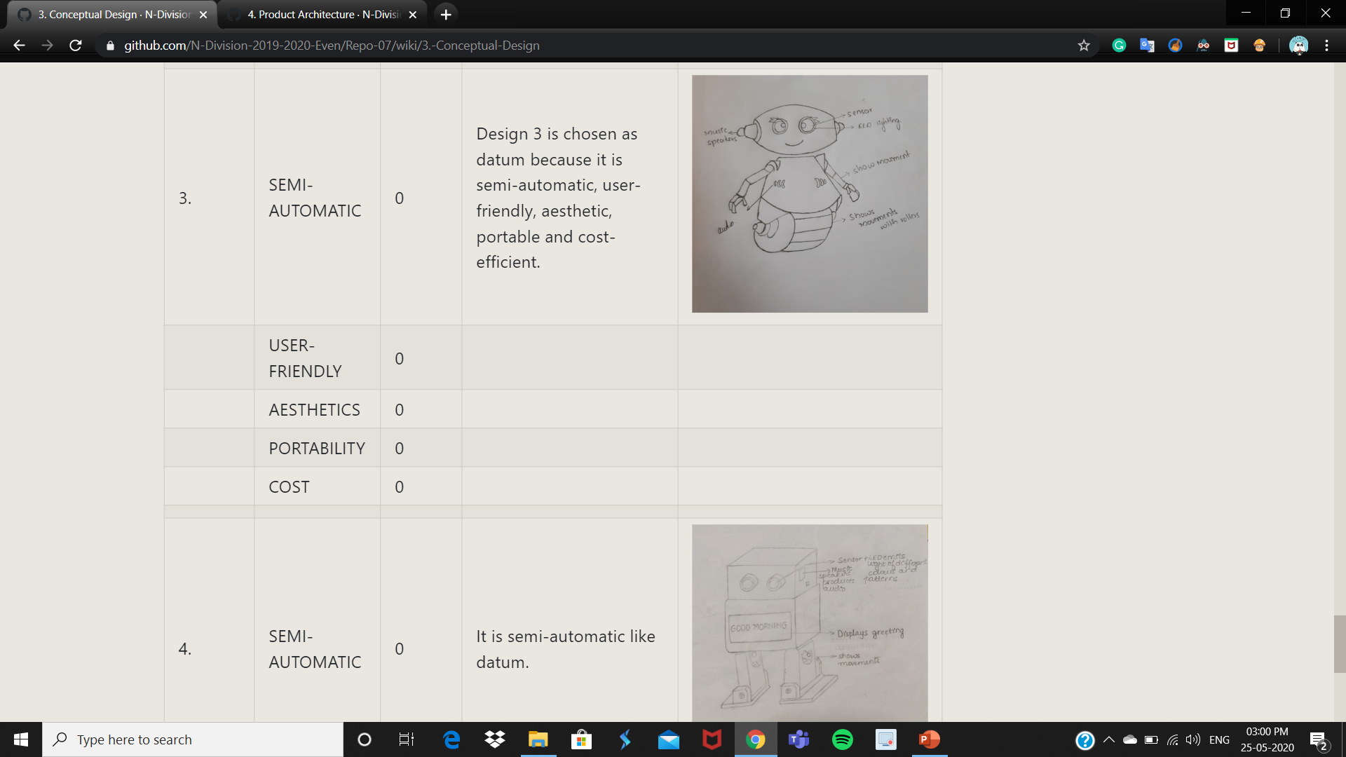

Slide 12
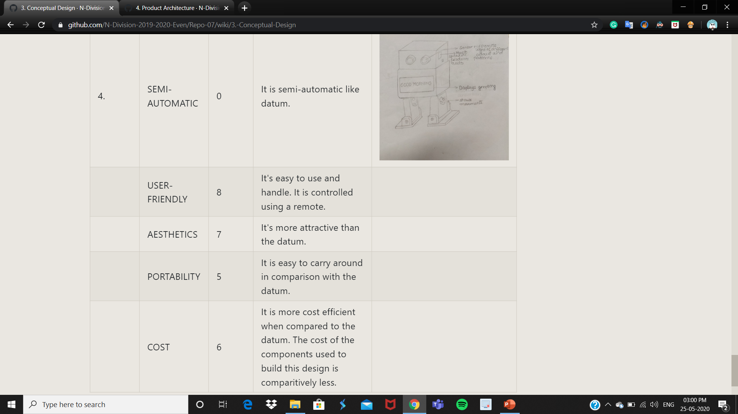

Slide 13
PRODUCT ARCHITECTURE

Slide 14
INTERFACE PERFORMANCE SPECIFICATIONS
Sensor Unit | Light Emitting Unit | Display Unit | Audio Unit | Movement Unit
Spatial interaction | No | No | No | No
Data interaction | Yes. Receives input(true) from the sensor and sends it to the light-emitting unit. | Yes. Receives input(false) from the sensor and send it to display unit. | No | No
Material interaction | No | No | Yes. Housed inside the head. | No

Slide 15
Light Emitting Unit | Sensor Unit | Display Unit | Audio Unit | Movement Unit
Spatial interaction | No | No | No | No
Data interaction | Yes. Receives input(true) from the sensor. | No | Yes. Sends data to the audio unit. | No
Material interaction | No | Yes. Housed inside the body. | No | Yes. Housed inside the body as well as legs.
Display Unit | Sensor Unit | Light Emitting Unit | Audio Unit | Movement Unit
Spatial interaction | No | No | No | No
Data interaction | Yes. Receives input(false) from the sensor. | No | No | No
Material interaction | No | Yes. Housed inside the body. | No | Yes. Housed inside the body as well as legs.

Slide 16
Audio Unit | Sensor Unit | Light Emitting Unit | Display Unit | Movement Unit
Spatial interaction | No | No | No | Yes. Legs move in only one direction, hence the degree of freedom=1
Data interaction | No | Yes. Receives data from the light-emitting unit. | No | Yes. Sends data to the movement unit.
Material interaction | Yes. Housed inside the head. | No | No | No
Movement Unit | Sensor Unit | Light Emitting Unit | Display Unit | Audio Unit
Spatial interaction | No | Yes. Legs move in only one direction, hence the degree of freedom=1 | Yes. Legs move in only one direction, hence the degree of freedom=1 | No
Data interaction | No | No | No | Yes. Receives data from the audio unit.
Material interaction | No | Yes. Housed inside the body as well as legs. | Yes. Housed inside the body as well as legs. | No

Slide 17
VIRTUAL IMPLEMENTATION

Slide 18

3D MODEL OF THE ENTIRE SYSTEM

Slide 19
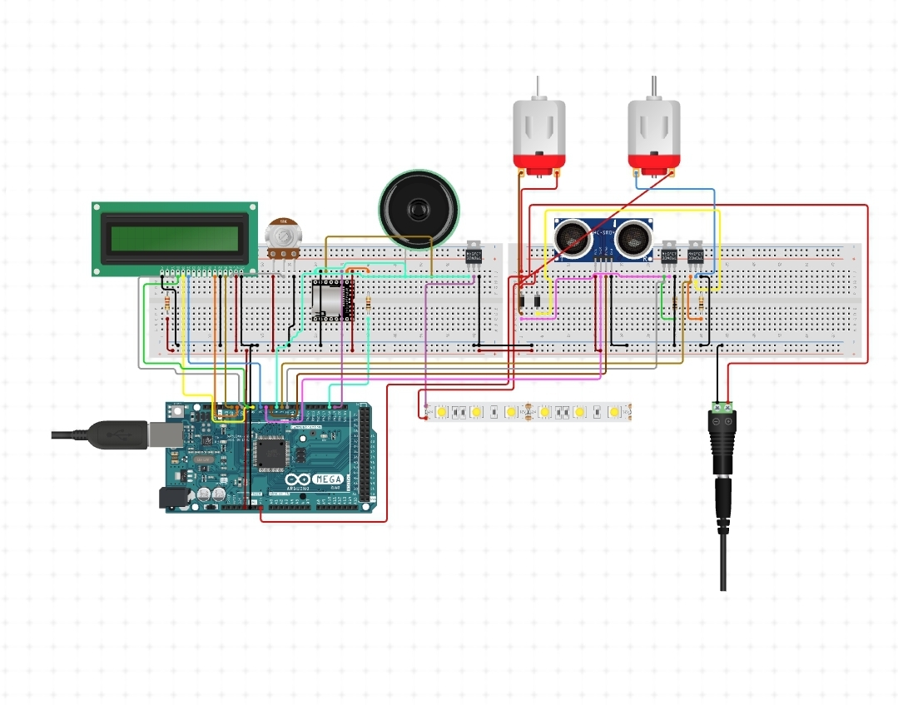
CIRCUIT DIAGRAM OF THE ENTIRE SYSTEM

Slide 20
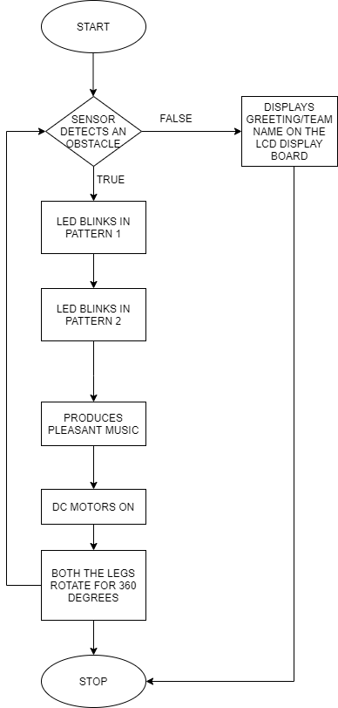
FLOW CHART OF THE ENTIRE SYSTEM

Slide 21
BILL OF MATERIALS FOR THE ENTIRE SYSTEM
Sl.no. | Part name | Material with which the part is made up of | Specifications of the part | Quantity required | Fabrication process if needed
1. | 3-D printed parts | Acrylic sheet | Tough, high strength(9x5x20)cm | 5 | Laser Cutting
2. | Housing of microcontroller | Acrylic sheet | (10X10X10)cm | 1 | Laser cutting
3. | DC motors | - | 100 gm(approx.),360 degrees | 2 | -
4. | Micro controller | Arduino mega | AT2560 | - | -
5. | Ultrasonic sensor | - | Range is 2cm to 8cm | 1 | -
6. | Screws | Steel |  | 10 | -

Slide 22
7. | Display Module | - | 4-Pin OLED Display Module | 1 | -
8. | Speakers | - | Operating voltage (DC): 4V to 5.5V,Voltage gain: Max 46 dB, Bandwidth: 20 kHz,LM386 audio amplifier | 1 | -
9. | Insulation tape | - | PVC,0.13 mm | 1 | -
10. | Jumper cables | - | Male-Female | 30 | -
11. | Jumper cables | - | Female-Female | 30 | -
12. | RGB LED strips | - | Circular,12 LEDs | 2 | -
13. | Shapes | Acrylic Sheet | Star,circle | 4 | Laser cutting
14. | Music player | - | Dynamic range support: 90dB | 1 | -

Slide 23
MOTOR SIZING AND BATTERY SIZING OF THE ENTIRE SYSTEM
BATTERY SIZING:
Maximum current drawn from dc motor = 300 mA
Running time = 3 hrs
Number of motors used = 2
Charge, Q =(Current drawn by motor)x(Running time)x(Number of motors used)
Q=(300x3x2)
Q=1800 mAh.
MOTOR SIZING:
The torque of the dc motor is calculated by T=F x D/2.
here F=m x g,
where m is the mass in kg and g is 9.81 ms^-2

Slide 24
F=m x g
= 1 x 9.81
= 9.81 N
D=25 mm=2.5 cm
Torque T=F x D/2
= 9.81 x 2.5/2
= 12.2625 N-cm
T=12.2625/g kg-cm, where g=9.81 m/s^2
= 12.2625/9.81
= 1.25 kg-cm
with reference to the rated torque, the speed of the motor should be 60 rpm.

Slide 25
FUNCTIONAL SPECIFICATIONS OF THE ENTIRE SYSTEM
FUNCTION | SPECIFICATIONS
Sense one's presence | It must sense people within a range of 2cm to 8cm.
Produce sound effects | It must produce music with 4 to 8-ohm speakers with the help of a music player.
Emit lights | It must emit lights of different colors and patterns for every 5 seconds. It emits a light pattern of 2 different types.
Show intricate movements | It must be able to rotate its legs.
Display greeting | Display greeting/team name on the display board.

Slide 26

MODELING AND SIMULATION

Slide 27
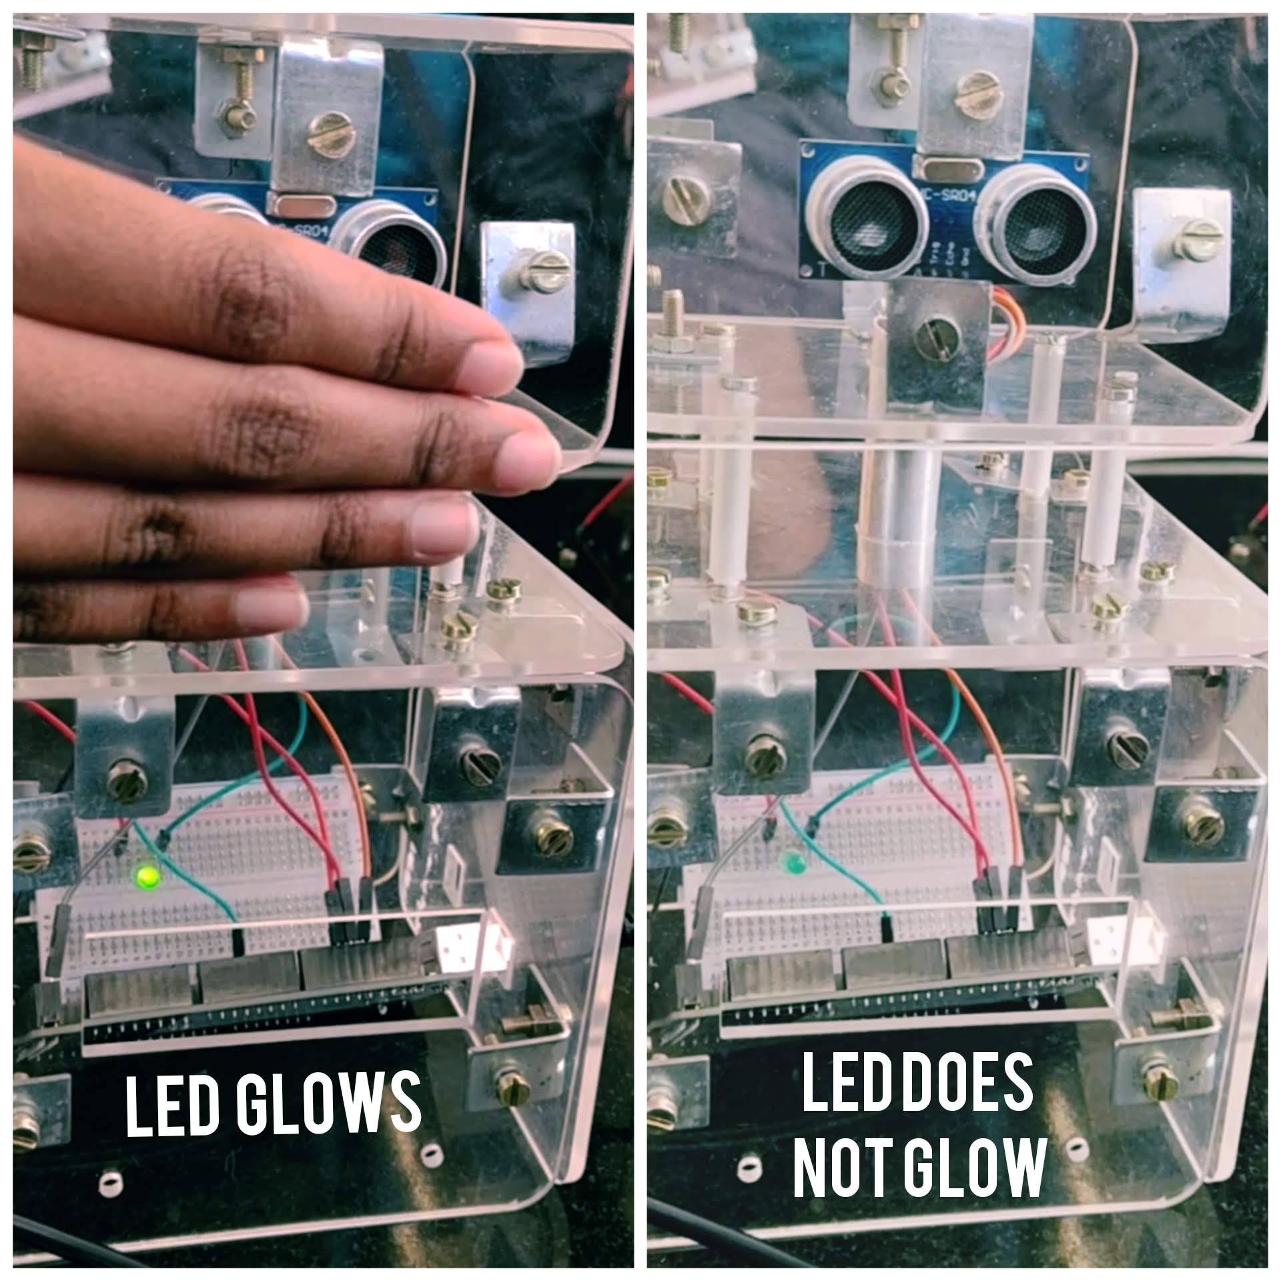
A GLIMPSE OF OUR PHYSICAL IMPLEMENTATION PROCESS
WHEN THE
ULTRASONIC SENSOR DETECTS AN OBSTACLE
WHEN THE
ULTASONIC SENSOR DOES NOT DETECT AN OBSTACLE

Slide 28
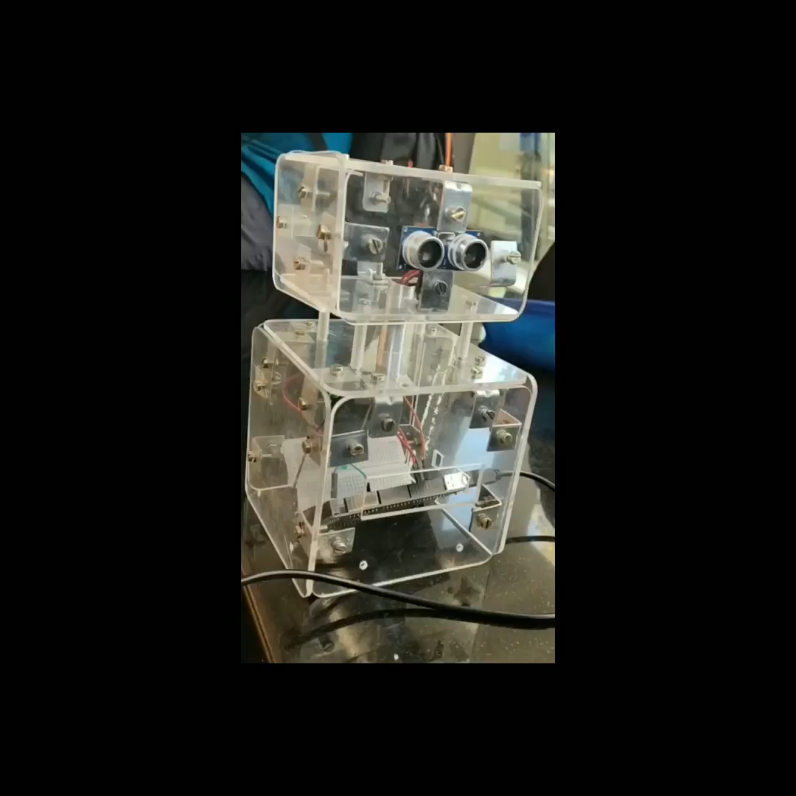

Slide 29
THANK YOU - GROUP 7 (N DIV)

